Slide 1
Progress Report 1 – 10/17/2017
Soumya MISHRA

Slide 2
PROBLEM
25% - 50% of what computers do require sorting algorithms for
Efficiency (speed)
Processing Data
Bioinformatics
GIS
Image Processing

Slide 3
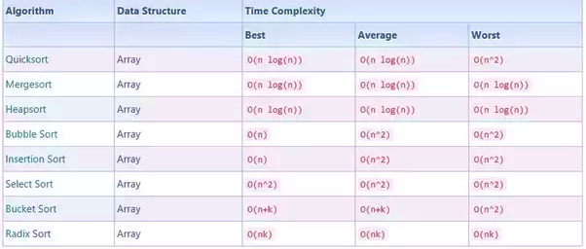
PROBLEM
Resource intensive iterative computing (multiple passes through same data set)
Large memory (RAM) requirements
Exponentially worse sorting time for large data sets

Slide 4
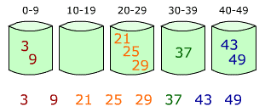
PROBLEM
Bucket sort
Sorts data into respective buckets
Uses merge sort to sort the buckets
Best case of O(n+k)
Worst Case of O(n^2)
Problems with Bucket sort
Too much of the data lies within a specific range – slows down algorithm
Takes up too much space for some buckets will not be used

Slide 5
A FASTER SORTING ALGORITHM
Reduces compute time and RAM requirements
Use statistical analysis to determine bucket ranges based on data set
<1000 elements in each bucket (number of elements are equal)
Should be able to sort data sets that follow any type of distribution
Worst case of O(6n)

Slide 6
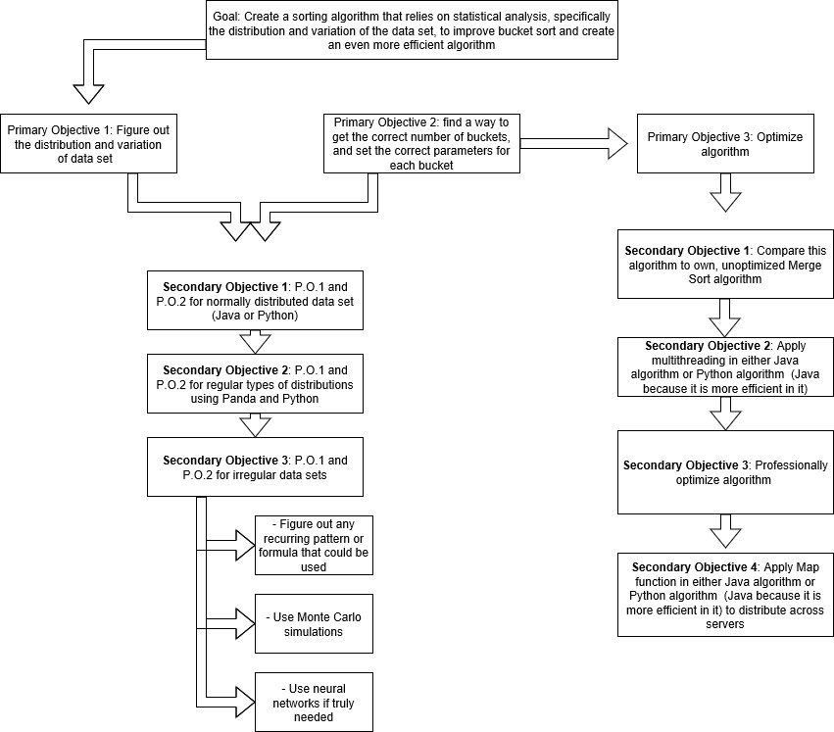

Slide 7
HOW WILL I CREATE THIS
Figure out distribution of data set – create bucket parameters
Java – normal distribution and collect data
Python – Panda to figure out distribution and collected data
Panda-like Method in Java to figure out distributions
See how Panda works and apply similar procedures
For irregular distributions, figure out pattern
Optimize Algorithm - Professionally
Multithreading
Map Function in Hadoop: MapReduce

Slide 8
PROJECT STATUS
Created backbone of algorithm in Java
Technical errors in preliminary code took time to figure out
Collected data when compared to Parallel Sort/Merge Sort
Transferring code into Python and learning Panda

Slide 9
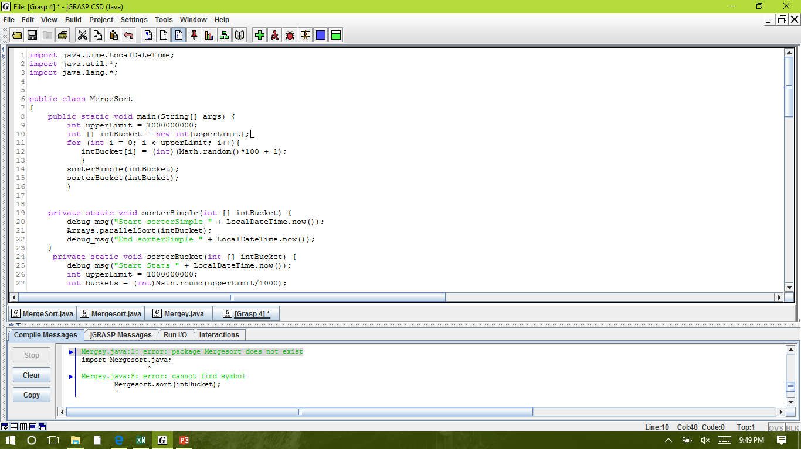
Backbone Code in Java – Main
Main method that creates the randomized array of normal distribution
Outputs parallel sort and new sort run times

Slide 10
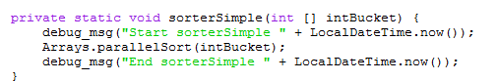
Backbone in Java – Parallel Sort
Getting run time of Parallel Sort – this is a Java merge-sort like sorting algorithm used to sort arrays by threading

Slide 11
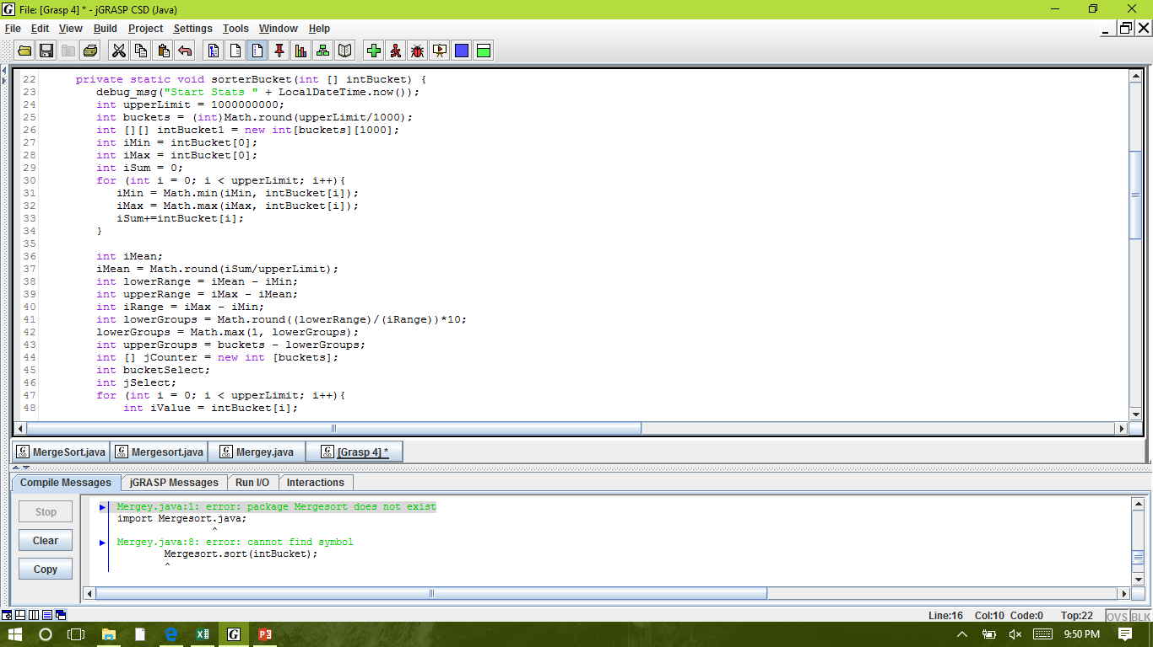
Backbone in Java – Stat Sort
This is the method that performs the new sort
This part of the method is calculating the
Max and min
mean
The lower range
The upper range
The number of buckets for the two ranges

Slide 12
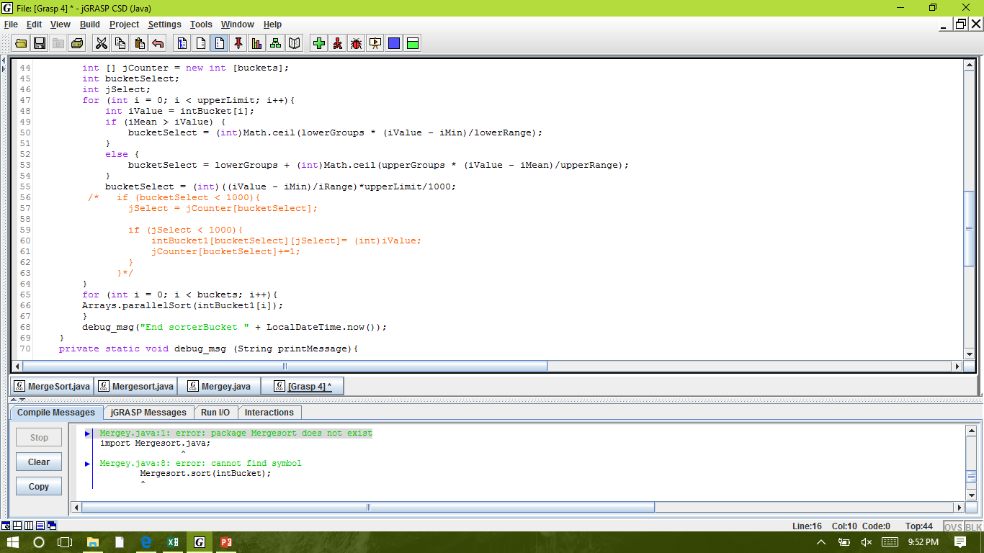
Backbone in Java – Buckets
This is the part of the method in which the elements are being sorted into their respective buckets
Inputs the end time of the sort which is used to calculated run time

Slide 13
Data Collected
 | Parallel Sort (Optimized) |  |  |  | New Sort |  |  |  | Percent Faster (%)*
Elements | Trial 1 (s) | Trial 2 (s) | Trial 3 (s) | Average (s) | Trial 1 (s) | Trial 2 (s) | Trial 3 (s) | Average (s)
1000 | 0.31 | 0.20 | 0.27 | 0.26 | 0.01 | 0.02 | 0.02 | 0.01 | 95.40
10000 | 0.31 | 0.36 | 0.37 | 0.35 | 0.02 | 0.01 | 0.02 | 0.01 | 96.04
100000 | 0.24 | 0.25 | 0.28 | 0.26 | 0.05 | 0.08 | 0.07 | 0.07 | 74.03
1000000 | 0.62 | 0.68 | 0.51 | 0.61 | 0.16 | 0.16 | 0.13 | 0.15 | 74.82
10000000 | 0.48 | 1.25 | 1.24 | 0.99 | 0.26 | 0.54 | 0.47 | 0.42 | 57.32
100000000 | 5.71 | 5.91 | 5.82 | 5.81 | 3.31 | 3.06 | 3.40 | 3.26 | 44.01
10000000000 | HEAP ERROR
*Efficiency apparently decreases – due to high standard error
Heap errors will be solved by using a 6-node server (later in the process)

Slide 14
Data Collected

Slide 15
Goals Until The Next Progress Report
Transfer algorithm into Python – next two weeks
Learn how to implement Panda and how Panda works– next four weeks
Use Panda in algorithm and check whether it will sort the data sets – whole of November, a bit into December
Implement Panda-like method into Java algorithm – November and December

Slide 16
REFERENCES
Wang, L., et al. (2012). G-Hadoop: MapReduce across distributed data centers for data-intensive computing. Future Generation Computer Systems. doi:10/1016/j.future.2012.09.00
Monaknov, A. (2016). Composable multi-threading for python libraries.
Goel, N., Laxmi, V., Saxena, A. (2015). Handling multithreading approach using java. International Journal of Computer Science Trends and Technology.3.2.
Hai, H., Guang-hui, J., & Xiao-tian, Z. (2013). A fast numerical approach for Whipple shield ballistic limit analysis. Acta Astronautica. 93. 112-120. Retrieved from http://dx.doi.org/10.1016/j.actaastro.2013.06.014
Dehne, F., & Zaboli, H. (2016). Parallel sorting for GPUs. Emergent Computation. 293 – 302. doi:10.1007/978-3-319-46376-6_12

